Slide 1

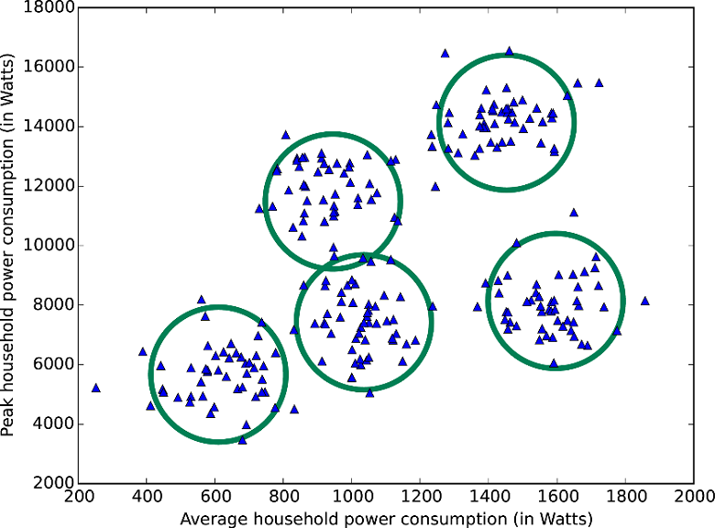
Clustering
By :- Ravi

Slide 2
Clustering
Clustering is the task of dividing the population or data points into a number of groups such that data points in the same groups are more similar to other data points in the same group than those in other groups. In simple words, the aim is to segregate groups with similar traits and assign them into clusters.
Clustering, or cluster analysis, is used for analyzing data which does not include pre-labeled classes. Data instances are grouped together using the concept of maximizing intraclass similarity and minimizing the similarity between differing classes.
Unsupervised Learning technique.

Slide 3
K-Means Clustering
K means is an iterative clustering algorithm that aims to find local maxima in each iteration.
Attempts to split data into K groups that are closest to K centroids.
- Randomly pick K centroids.
- Assign each data point to the centroid it’s closest to
- Recompute the centroids based on the average position of each centroid’s points.
If you want to predict the cluster for new points, just find the centroid they are closest to.

Slide 4
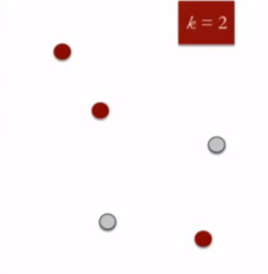
K-Means Clustering Working
This algorithm works in these 5 steps :
Specify the desired number of clusters K : Let us choose k=2 for these 5 data points in 2-D space.

Slide 5
K-Means Clustering Working
Randomly assign each data point to a cluster : Let’s assign three points in cluster 1 shown using red color and two points in cluster 2 shown using grey color.

Slide 6
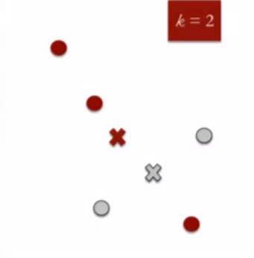
K-Means Clustering Working
Compute cluster centroids : The centroid of data points in the red cluster is shown using red cross and those in grey cluster using grey cross.

Slide 7
K-Means Clustering Working
Re-assign each point to the closest cluster centroid : Note that only the data point at the bottom is assigned to the red cluster even though its closer to the centroid of grey cluster. Thus, we assign that data point into grey cluster

Slide 8
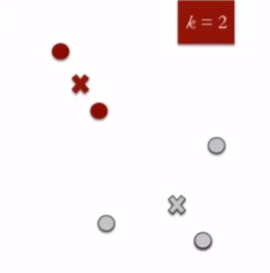
K-Means Clustering Working
Re-compute cluster centroids : Now, re-computing the centroids for both the clusters.

Slide 9
Hierarchical Clustering
Hierarchical clustering, as the name suggests is an algorithm that builds hierarchy of clusters. This algorithm starts with all the data points assigned to a cluster of their own. Then two nearest clusters are merged into the same cluster. In the end, this algorithm terminates when there is only a single cluster left.

Slide 10
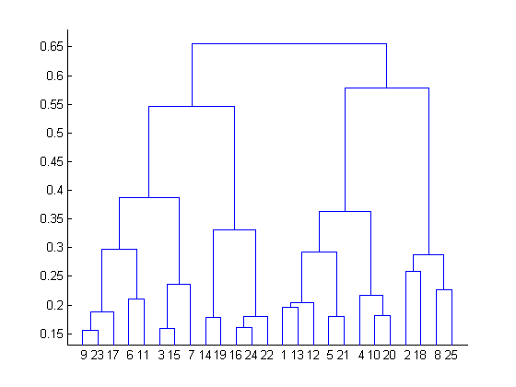
Hierarchical Clustering
The results of hierarchical clustering can be shown using dendrogram. The dendrogram can be interpreted as:

Slide 11
Difference between K Means and Hierarchical clustering
Hierarchical clustering can’t handle big data well but K Means clustering can. This is because the time complexity of K Means is linear i.e. O(n) while that of hierarchical clustering is quadratic i.e. O(n²).
In K Means clustering, since we start with random choice of clusters, the results produced by running the algorithm multiple times might differ. While results are reproducible in Hierarchical clustering.
K Means is found to work well when the shape of the clusters is hyper spherical (like circle in 2D, sphere in 3D).
K Means clustering requires prior knowledge of K i.e. no. of clusters you want to divide your data into. But, you can stop at whatever number of clusters you find appropriate in hierarchical clustering by interpreting the dendrogram

Slide 12
Applications of Clustering
Recommendation engines
Market segmentation
Social network analysis
Search result grouping
Medical imaging
Image segmentation
Anomaly detection

Slide 13
CLUSTERING
Clustering is the task of dividing the population or data points into a number of groups.
Data points in the same groups are more similar to other data points in the same group and dissimilar to the data points in other groups.
It is basically a collection of objects on the basis of similarity and dissimilarity between them.

Slide 14
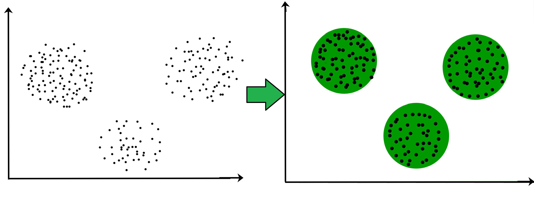
CLUSTERING

Slide 15
CLUSTERING ALGORITHM
K means Clustering
K-means clustering is a type of unsupervised learning, which is used when you have unlabeled data (i.e., data without defined categories or groups).
The goal of this algorithm is to find groups in the data, with the number of groups represented by the variable K.
The algorithm works iteratively to assign each data point to one of K groups based on the features that are provided.
Data points are clustered based on feature similarity.

Slide 16
CLUSTERING ALGORITHM
The results of the K-means clustering algorithm are:
The centroids of the K clusters, which can be used to label new data
Labels for the training data (each data point is assigned to a single cluster)

Slide 17

CLUSTERING ALGORITHM

Slide 18
CLUSTERING ALGORITHM
The Κ-means clustering algorithm uses iterative refinement to produce a final result.
The algorithm inputs are the number of clusters Κ and the data set.
The data set is a collection of features for each data point.
The algorithms starts with initial estimates for the Κ centroids, which can either be randomly generated or randomly selected from the data set.

Slide 19
The algorithm then iterates between two steps:
Data assignment step
Centroid update step
The algorithm iterates between steps one and two until a stopping criteria is met (i.e., no data points change clusters, the sum of the distances is minimized, or some maximum number of iterations is reached)

Slide 20
Hierarchical Clustering
Hierarchical clustering is one of the popular and easy to understand clustering technique.
This clustering technique is divided into two types:
Agglomerative
Divisive

Slide 21
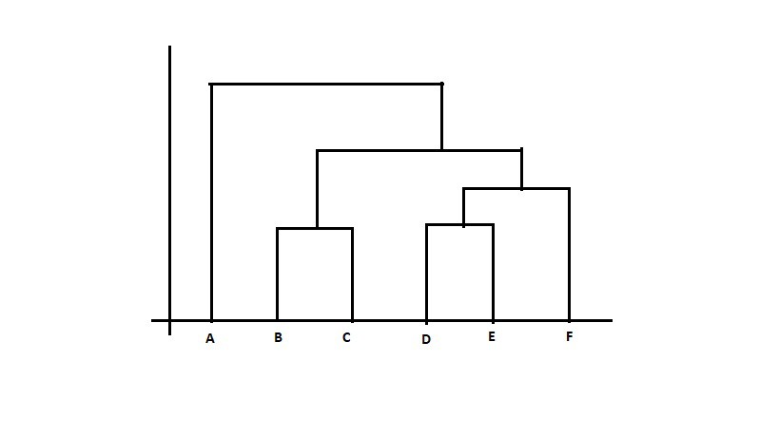
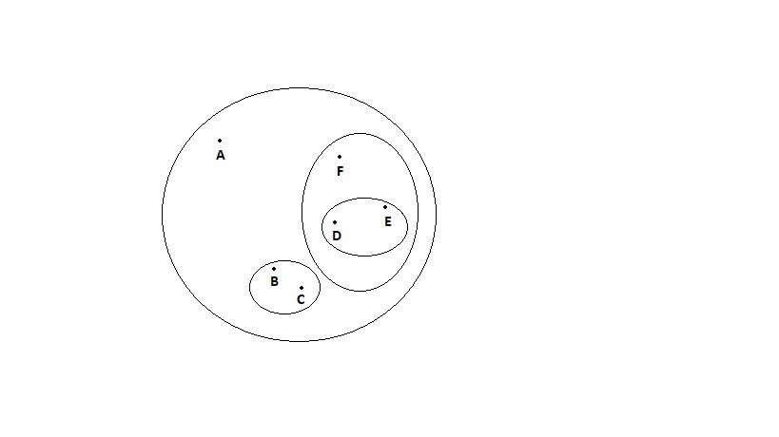
Hierarchical Clustering
The Hierarchical clustering Technique can be visualized using a Dendrogram.
A Dendrogram is a tree-like diagram that records the sequences of merges or splits.

Slide 23
Agglomerative Hierarchical clustering Technique:
In this technique, initially each data point is considered as an individual cluster.
At each iteration, the similar clusters merge with other clusters until one cluster or K clusters are formed.

Slide 24
Agglomerative Hierarchical clustering Technique:
The basic algorithm of Agglomerative is straight forward.
Compute the proximity matrix
Let each data point be a cluster
Repeat: Merge the two closest clusters and update the proximity matrix Until only a single cluster remains

Slide 25
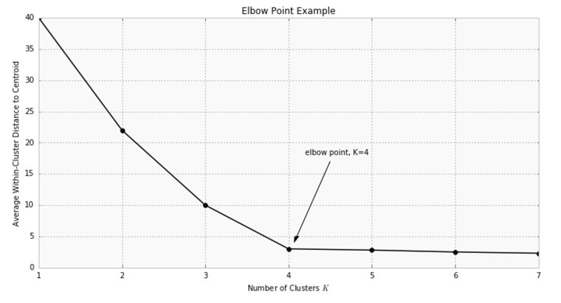
Choosing k : How to examine the Value of k (Clusters)?

Slide 26
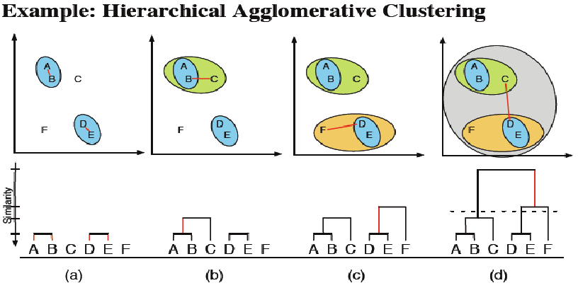

Slide 27
2. Divisive Hierarchical Clustering
The Divisive Hierarchical clustering is exactly the opposite of the Agglomerative Hierarchical clustering.
In Divisive Hierarchical clustering,
we consider all the data points as a single cluster and in each iteration, we separate the data points from the cluster which are not similar.
Each data point which is separated is considered as an individual cluster. In the end, we’ll be left with n clusters.
As we’re dividing the single clusters into n clusters, it is named as Divisive Hierarchical Clustering.

Slide 28
DENSITY BASED CLUSTERING
Density based clustering algorithm has played a vital role in finding non linear shapes structure based on the density. Density-Based Spatial Clustering of Applications with Noise (DBSCAN) is most widely used density based algorithm.

Slide 29
DBSCAN Clustering:
DBSCAN stands for
Density-Based Spatial Clustering of Applications with Noise
DBSCAN is a clustering method that is used in machine learning to separate clusters of high density from clusters of low density.

Slide 30
DBSCAN Clustering:
DBSCAN is a density based clustering algorithm.
It does a great job of seeking areas in the data that have a high density of observations, versus areas of the data that are not very dense with observations.
DBSCAN can sort data into clusters of varying shapes as well, another strong advantage

Slide 31
DBSCAN works as such:
Divides the dataset into n dimensions
For each point in the dataset, DBSCAN forms an n dimensional shape around that data point, and then counts how many data points fall within that shape.
DBSCAN counts this shape as a cluster. DBSCAN iteratively expands the cluster, by going through each individual point within the cluster, and counting the number of other data points nearby.

Slide 32
DBSCAN algorithm has two parameters:
ɛ: The radius of our neighborhoods around a data point p.
minPts: The minimum number of data points we want in a neighborhood to define a cluster.

Slide 33
Using these two parameters, DBSCAN categories the data points into three categories:
Core Points: A data point p is a core point if Nbhd(p,ɛ) [ɛ-neighborhood of p] contains at least minPts ; |Nbhd(p,ɛ)| >= minPts.
Border Points: A data point *q is a border point if Nbhd(q, ɛ) contains less than minPts data points, but q is reachable from some core point p.
Outlier: A data point o is an outlier if it is neither a core point nor a border point. Essentially, this is the “other” class.

Slide 34
DBSCAN works as such:
Divides the dataset into n dimensions
For each point in the dataset, DBSCAN forms an n dimensional shape around that data point, and then counts how many data points fall within that shape.
DBSCAN counts this shape as a cluster. DBSCAN iteratively expands the cluster, by going through each individual point within the cluster, and counting the number of other data points nearby.

Slide 35
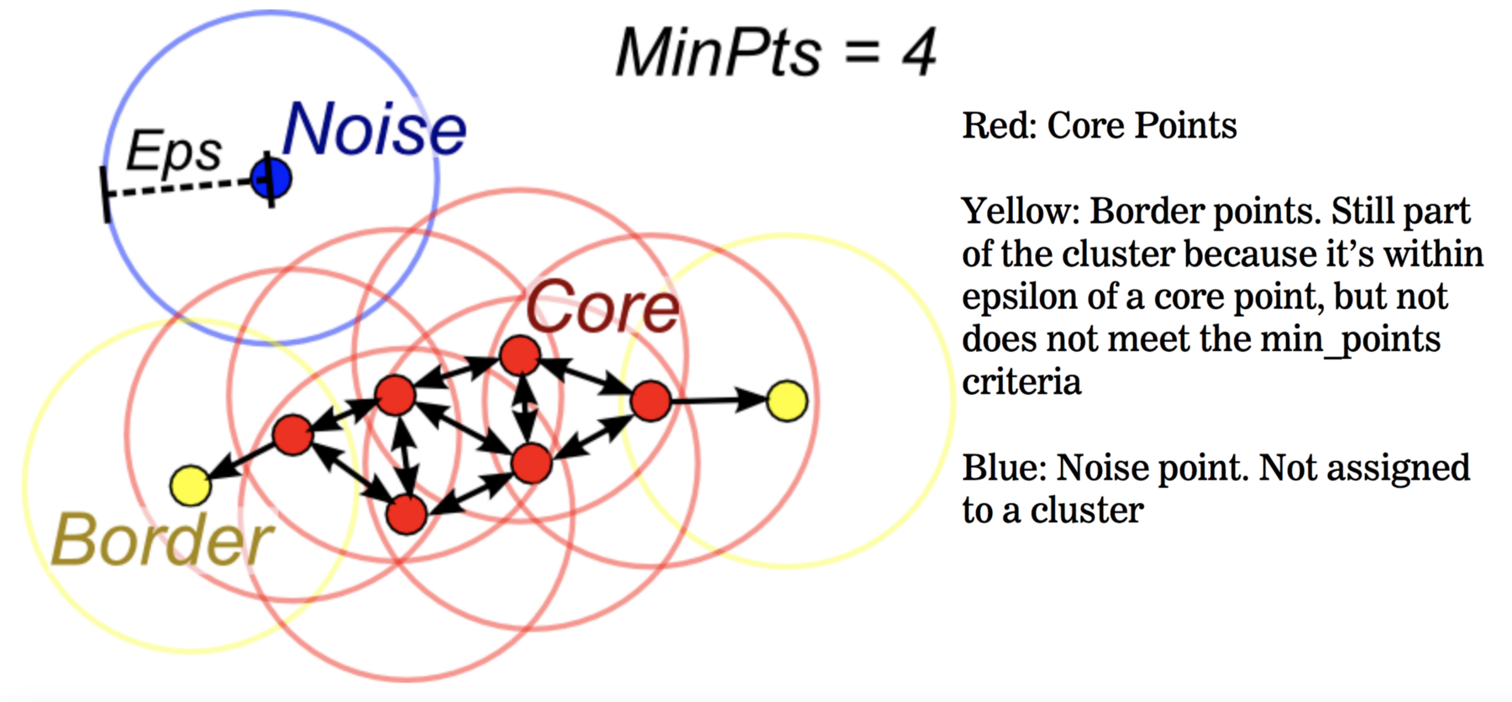

Slide 36
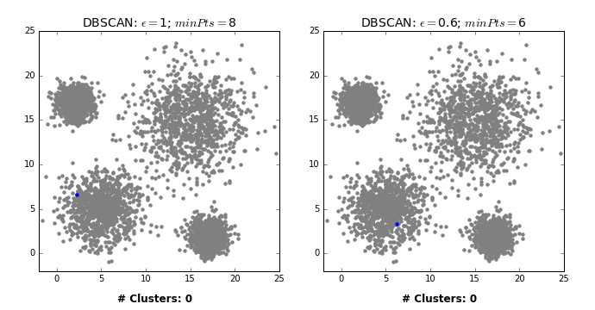

Slide 37
Mean shift clustering
Mean shift is a clustering algorithm that assigns the datapoints to the clusters iteratively by shifting points towards the mode.
The mode can be understood as the highest density of datapoints (in the region, in the context of the Mean shift). As such, it is also known as the mode-seeking algorithm.
Mean shift algorithm has applications in the field of image processing and computer vision.

Slide 38
Mean shift clustering
Given a set of datapoints, the algorithm iteratively assign each datapoint towards the closest cluster centroid.
The direction to the closest cluster centroid is determined by where most of the points nearby are at. So each iteration each data point will move closer to where the most points are at, which is or will lead to the cluster center.
When the algorithm stops, each point is assigned to a cluster.
Unlike the popular K-Means algorithm, meanshift does not require specifying the number of clusters in advance.
The number of clusters is determined by the algorithm with respect to the data.

Slide 39
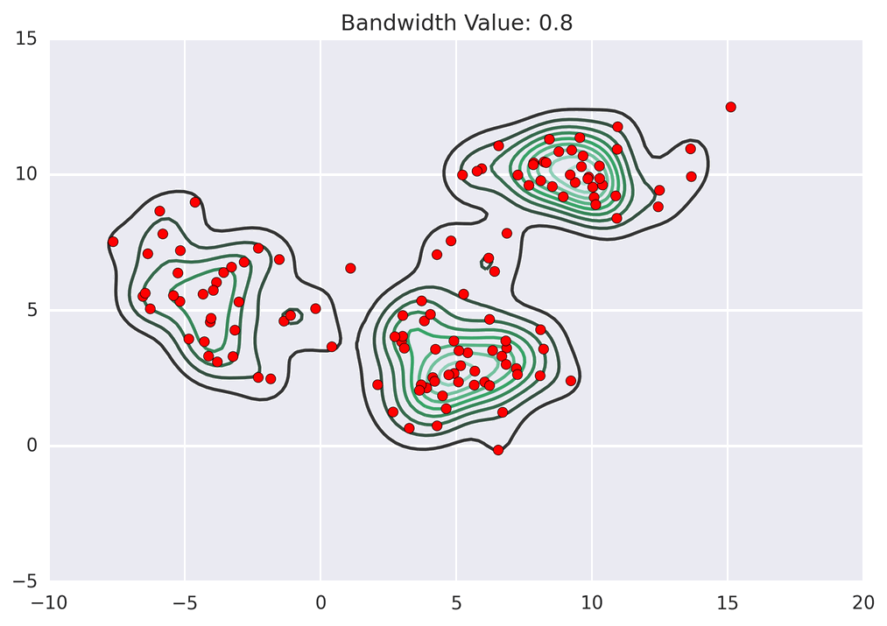

Slide 40
Principle Component Analysis : Dimensionality Reduction Technique
This technique extracts some amount of features from the original dataset.
These extracted features/variables are called Principal Components.
The main motive behind this technique is to extract a low dimensional set of features from a high dimensional dataset.
It is more useful when we are dealing with 3 or high dimensional data.

Slide 41
Principle Component Analysis : Dimensionality Reduction Technique
If we want to perform this technique, then the matrix must contain numeric and standardize data.
If we want to perform this technique, then the matrix must contain numeric and standardize data.
PCA is a linear combination of original variables.
The first principal component should explain the maximum variance in the dataset.
And the remaining variance is being explained by the second principal component. These components are uncorrelated, and the cycle goes on.

Slide 42
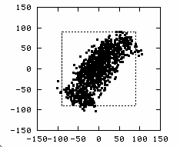
PCA : Dimensionality Reduction : Applications
Face Recognition
Image Compression
Gene Expression Analysis
Data Reduction
Data Classification
Trend Analysis
Factor Analysis
Noise Reduction

Slide 43
Steps of PCA :-
Let be the mean vector (taking the mean of all rows)
Adjust the original data by the mean
X’ = X –
Compute the covariance matrix C of adjusted X
Find the eigenvectors and eigenvalues of C.

Slide 44
Eigenvalues & Eigenvectors
Vectors x having same direction as Ax are called eigenvectors of A (A is an n by n matrix).
In the equation Ax=λx, λ is called an eigenvalue of A.

Slide 45
Eigenvalues
Calculate eigenvalues λ and eigenvectors x for covariance matrix:
Eigenvalues λ_{j} are used for calculation of [% of total variance] (V_{j}) for each component j:

Slide 46
Principal components - Variance

Slide 47
Transformed Data
Eigenvalues λ_{j} corresponds to variance on each component j
Thus, sort by λ_{j}
Take the first p eigenvectors e_{i;} where p is the number of top eigenvalues
These are the directions with the largest variances

Slide 48
PCA –> Original Data
Retrieving old data (e.g. in data compression)
RetrievedRowData=(RowFeatureVector^{T} x FinalData)+OriginalMean
Yields original data using the chosen components

